Slide 1
A/C Safety Concerns

Slide 2
Safety First
Like many other complex machines, A/C systems present several potential sources for injury. The wise technician is aware of these potential problems and is careful to prevent them from occurring. There are several areas for concerns: the refrigeration system, moving engine parts, and electrical systems.
Notes:
Like any other system on equipment, there are always safety concerns. Always remove bucket or attachment, raise and support machine, install proper lift arm support.

Slide 3
Potential Hazards
Pressurized Refrigerant
Frostbite
Asphyxiation
Flammable Refrigerant
Exploding Container
Phosgene-like gas
Moving engine parts
Electrical circuits

Slide 4

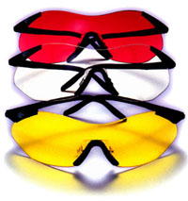
Personal Protective Equipment
A wise technician wears eye and hand protection while performing service or repairs on an A/C system. R134A boiling point is -15°F.

Slide 5
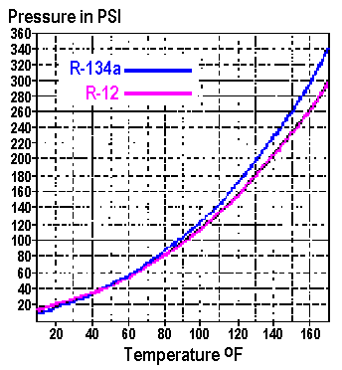
Liquid R-12 & R-134a
Refrigerant pressure is directly related to its temperature, and this pressure is trying to escape from a system. It can drive oil or dirt particles into eyes and skin, and it tries to blow system components apart.

Slide 6
Frostbite
Boiling point of R134a is -15° F.
Boiling point of R12 is -21° F.
If liquid refrigerant is released, it will boil immediately and lower the temperature of whatever it touches down to its boiling point. Both of these refrigerants have a boiling point well below freezing.
Notes:
Boiling point of R134a is -15.34° F.
Boiling point of R12 is -21.64° F.

Slide 7

Asphyxiation
Neither R-12 nor R-134a contain any oxygen; they will not support life. They are both heavier than air, and if released into a confined space, will displace air.
Notes:
Work in well ventilated areas.

Slide 8
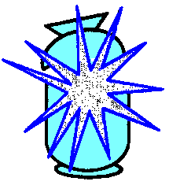
Exploding Containers
The liquid volume in a container expands as it is heated. If it fills the container, the pressure can cause the container to explode. An exploding container will release the refrigerant which will immediately boil.
Notes:
Do not expose refrigerant containers to excessive heat, do not store in direct sunlight.

Slide 9
Safe Handling of Refrigerant
Store refrigerants in a clean, dry area out of direct sunlight.
Never tamper with cylinder valves or pressure relief devices
Never refill disposable cylinders with anything. Do not use as compressed air tanks.
Wear protective clothing
Avoid contact with refrigerant because frostbite may occur

Slide 10
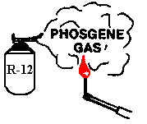
Carbonyl Fluoride
R-12 (Cl₂Fl₂C) breaks down to carbonyl fluoride (COF₂) when burned. It is similar to Phosgene (CCl₂O) gas but not quite as deadly. R-12 sucked into a running engine or through a burning cigarette will also produce carbonyl fluoride.
Notes:
One of the dangers of R12

Slide 11
Fans and Drive Belts
Always use caution when working close to the moving drive belts and fan. Remember that electric fans on some vehicles can start and stop on their own, even with the engine off.

Slide 12
Electrical Circuits
A vehicle’s electrical system presents several potential hazards:
Electrical shock, especially with 42 volt and higher systems
If a metal tool grounds out a system, arc/flash and tool burning can occur
Batteries can explode

Slide 13
The End

